Slide 1
Bright Futures
Eligibility requirements are subject to change with each legislative session.

Slide 2
Table of contents
Eligibility Requirements
Chart of Requirements
Renewal Requirements
Community Service Specifics
Community Service Forms
How to track your progress towards earning BF
Bright Futures Student Handbook

Slide 3
Initial eligibility Requirements
Submit Florida Financial Aid Application (FFAA) at www.floridastudentfinancialaid.org by August 31 after high school graduation
Opens October 1 of senior year
Complete the 16 college-prep courses required for admission to a state university
Achieve required weighted GPA in the 16 college-prep courses per chart on next slide
Complete number of services hours per chart on next slide
Achieve required combined ACT or SAT score per chart on next slide

Slide 4
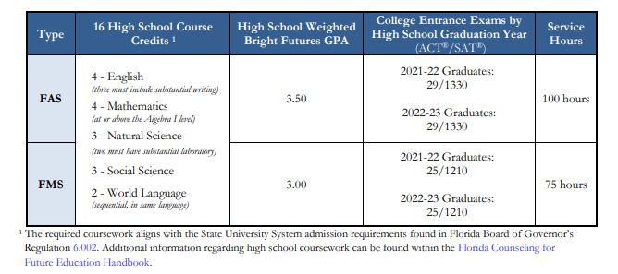
Requirements

Slide 5
Requirements to receive award
Evaluated by Office of Student Financial Assistance (OSFA) as meeting the initial eligibility requirements
Graduated with a standard high school diploma or equivalent
Be a FL resident and U.S. citizen or eligible noncitizen
Enroll as a degree- or certificate-seeking student at a FL institution in at least 6 non-remedial semester credit hours

Slide 6
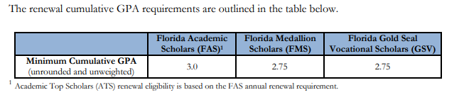
Renewal Requirements
Students must earn the number of credit hours based on the student’s enrollment type per term, and
The renewal cumulative GPA requirements are outlined in the table below

Slide 7
Community Service

Slide 8
Community Service Requirements
Student identifies a social issue, develops plan of personal involvement in addressing the issue and evaluate and reflect upon the experience.
Service may be performed at more than one agency and address more than one social issue, however, student needs to complete proposal form for each agency and it needs to be approved by high school counselor/community service designee. If approved, the student completes separate log and reflection form for each agency.
Must be a high school student enrolled in grades 9-12. Students are considered high school students beginning the summer before 9th grade.
If student transfers to a Pinellas County HS from a Florida public or private high school, the community service hours earned will be honored if previous school verifies hours. Students in Florida homeschool will have their hours honored if they provide documentation on agency letterhead of the number of hours earned and dates of service completed. Out-of-state students and in-state students without documentation from their previous school may complete the community service project form #1 (PCS Form 2-2602-2) for review by the community service designee. If approved, student completes log form (PSC Form 2-2602-3) and hours will be accepted.

Slide 9
What does not count as Community Service?
Court mandated community service
Activities for which students benefit financially or materially for the community service work
All forms of duty within the family. The student’s family to include; parents (including step), siblings (including step), any of their grandparents (including step) and any of their spouses, aunts, uncles, cousins, nieces and nephews.
Activities which can be interpreted primarily as proselytizing or religious devotion
Activities where there is no leader or responsible adult on site to evaluate and confirm student performance (i.e., fostering an animal in your home).
Donations such as Locks of Love or giving blood
Except for credit earned through service learning courses adopted pursuant to section 1003.497, FL Statute, students may not receive academic credit for service work performed
An activity performed by a student prior to becoming a high school student or after their graduation date.
Participation on a sports team or a performance of any kind.

Slide 10
Community Service Documentation
Student should get a copy of PCS Form 2-2602-2 (BF Proposal Form)
Determine where they’d like to complete their community service
Contact the agency and find out the procedures to volunteer
Student completes BF Proposal Form in its entirety and submits to school counselor for approval
After approval, student should log community service hours on PCS Form 2-2602-3 (BF Log Form).
Once student has completed community service hours with agency, they should ensure they have completed the log form in its entirety. Then, submit it to the school counselor.
School counselor will review form, confirm student has an approved Proposal Form, and sign off if all paperwork is in order. The hours will be added to Focus by the staff person assigned this responsibility.
Completed forms shall be placed in student’s official cumulative file at the high school.

Slide 11
Community service FORMS
Student Community Service Information Sheet
https://www.pcsb.org/cms/lib/FL01903687/Centricity/domain/176/pcs%20forms/2-2602-1.pdf
Bright Futures Community Service Proposal Form
https://www.pcsb.org/cms/lib/FL01903687/Centricity/domain/176/pcs%20forms/2-2602-2.pdf
Bright Futures Community Service Log and Reflection Form
https://www.pcsb.org/cms/lib/FL01903687/Centricity/domain/176/pcs%20forms/2-2602-3.pdf

Slide 12
Bright Futures Student Handbook
https://www.floridastudentfinancialaidsg.org/SAPBFMAIN/SAPBFMAIN

Slide 13
Paying for college webinar For SPCHS students and families of all grades
Michelle Gonzalez, Director, Enrollment Services
Florida Gulf Coast University
Thursday, September 16th
6:00 Virtual Meeting
Join Zoom Meeting
https://spcollege.zoom.us/j/95305386515?pwd=Y3F6c3dkWVU5ajg3M2Nhc3hLNzZ0dz09
Remember the FAFSA and FFAA open on October 1st! We will do the FFAA in Seminar!

